Slide 1
The Relational Database and
Its Predecessors
Topic 2
Readings:
Chapter 3: The Relational Data Model
Chapter 9: ER and ERR to Relational Mapping, and Other Relational Languages (9.1)
CS319

Slide 2
The Problem:
Now that we have figured out how to represent our data as a simple paper MODEL (the ER Diagram)….. How do we translate that ER model to a REAL working database on a computer?
CS3319

Slide 3
TOPICS
Hierarchical Database Model
Network Database Model
Relational Database Model
CS3319

Slide 4
Hierarchical Data Model
Most popular DBMS using this model is IBM's IMS (STILL BEING USED!)
Based on 2 main concepts: records and parent-child relationships. Records are grouped into record types
A parent-child relationship type is a 1:M relationship between 2 record types
An occurrence (instance) of a Parent/Child relationship is 1 parent record type and a number of records from the child type
CS319

Slide 5
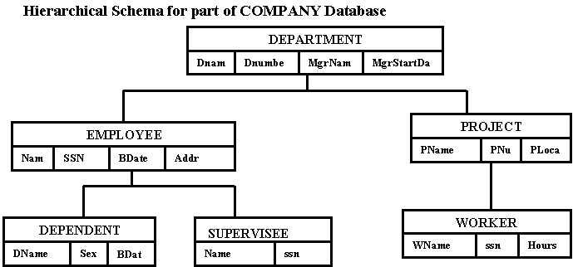
Example:
Question: Can you see where there will be a data redundancy (a problem)?
CS319

Slide 6
What is the problem…
with the Hierarchical Model?
CS3319

Slide 7
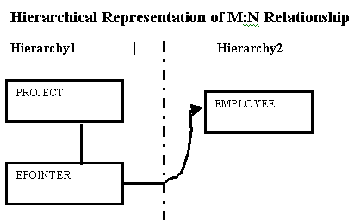
Has problems modeling the following situations:
M:N relationships
The case where a record type participates as child in more than 1 Parent/Child relationship type (redundancy)
N-ary relationships with more than 2 participating types
Mapping ER Diagram to Hierarchical Model :
In Hierarchical Models only 1:N representations can be modeled so for M:N relationships represent them as if they were 1:N relationships, and use pointers to save on duplication of data
CS319

Slide 8
Network Data Model
Designed and created by the CODASYL (Conference on Data System Languages) committee in 1971
Often called the CODASYL Model (popular DBMS using this model is IDMS)
Two basic data structures: Records and Sets
Data stored as Records, Records as classified into Record Types (Record Types have a name and format for each data item)
CS319

Slide 9
Set type is a 1:N relationship between 2 record types. Each set type consists of 3 elements
  A name for the set
  An owner record type
  A member record type
A record type can participate as an owner or member in any number of set types
Uses circular linked lists
CS319

Slide 10
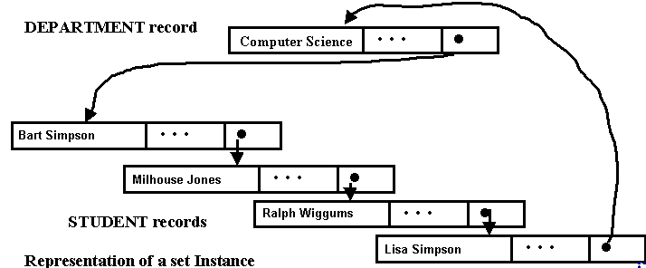
Example:
This model allows us to do things such as:
Given an owner record, find all member records of the set occurrence
Given an owner record, find the first or nth, or last record of that set occurrence
Given a member record, find the next or previous member record
Given a member record, find the owner record
CS319

Slide 11
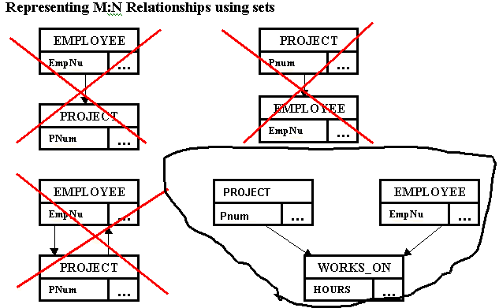
CS319

Slide 12
Mapping an ER diagram to Network Model
  Step 1: Regular Entities --> Create a record type
  Step 2: Weak Entities --> Create a record type
  Step 3: One to One and One to Many --> Create a set type relating record type S1 to S2. For one-to-one arbitrarily choose one of S1 or S2 as owner, for one-to-many choose make the owner be the One side of the One-to-Many relationship
  Step 4: Many to Many --> Create a linking type X and make it the member record type in the 2 set types.
CS319

Slide 13

Relational Data Model
Introduced by Codd in 1970
Most DBMS are based on this model
Represents the database as a collection of relations.
Each relation is a table: a table is a set of rows, where each row in the table represents a collection of related data values
CS319

Slide 14

First let’s learn some terminology
CS3319

Slide 15
A Domain D is a set of atomic values, Example: USA_Phone_Numbers, Employee_Ages, Department IDs
  Set of 10 digit phone numbers valid in Canada
  Possible ages of employees
  A data type is specified for each domain like 10 char string or positive integer
A Relation Schema R denoted by R(A1, A2, ...An) is made up of a relation name and a list of attributes. Each attribute Aj is the name of a role played by some domain D in the relation schema R.
R is called the name of the relation
Attribute is a named column in a relation
Tuple is a row of a relation
Degree of a relation is the number of attributes it contains
Cardinality of a relation is the number of tuples it contains
CS319

Slide 16
A relation (or relation state)
  r of a relation schema R(A1, A2, .... An) also denoted by r(R) is a set of n-tuples r = {t1, t2, ... tm}. Each n-tuple t is an order list of n values t=< v1, v2, ... ______> , where each value vi, 1<=i<=n, is an element of dom(Ai) or a special null value.
Mathematical Relations:
  Suppose we have 2 set D1 = {2,4} and D2 = {1,3,5}. The Cartesian product D1 X D2 represents all possible ordered pairs:
    {(2,1), (2,3), (2,5), (4,1), (4,3), (4,5)} Any subset of D1 X D2 represents a relation --> R = {(2,5), (4,1)}
  We could have three sets: D1, D2 and D3 and build a relation on D1 X D2 X D3, in general we write:
CS319

Slide 17
QUESTION: If we have:
D1= {Simpson, Flanders, Smithers}
D2 = {Homer, Ned}
D3 = {40,30}
What would D1 X D2 X D3 give us:
CS319

Slide 18
Properties of Relations:
Each relation name is
Each cell in a relation contains 1 atomic value (Normalized, First Normal Form)
Each attribute name within a table is
The values of an attribute are from the same domain
The order of the attributes has no significance
Each tuple is distinct (no duplicates)
The order of the tuples has no significance (Tuples in a relation do not have any particular order, however in a file records are physically stored on disk so there is always an order among records. Note: we may chose to display the records in a particular order)
CS319
Notes:
Unique
Unique

Slide 19
MOST OF THE ABOVE PROPERTIES ARE FROM MATHEMATICAL RELATIONS
  Since a relation is a set, the order doesn't matter, therefore the order of the tuples doesn't matter.
  In a set, no elements are repeated, therefore tuples are unique
  Mathematical Relations are not necessarily normalized (reduced redundancy) however Codd chose Relations to be.
  In a relation, possible values for a given position are determined by the set or domain on which the position is defined, thus in a table the values in a column must come from the same domain.
CS319

Slide 20
Example:
Attribute: (there are 5 attributes in this table)
Relation (or Table)
Employee
SSN | FirstName | LastName | Department | Position
123 | Laura | Reid | Computer Science | Lecturer
005 | Bob | Bryan | Math | Professor
125 | Sylvia | Osborn | Computer Science | Professor
137 | Bob | Bryan | Math | Professor
Key (each tuple must be different)
Tuple (there are 4 tuples in this table)
Domain Sample Domain: domain of SSN is 000 to 999 in this table
CS319

Slide 21
Relational Constraints
Keys and Key Constraints
Keys → used to enforce that no 2 tuples can be identical
QUESTION: What is the key of this table?
SSN | LastName | FirstName
34 | Simpson | Homer
56 | Simpson | Marge
78 | Smithers | Marge
99 | Simpson | Homer
CS319

Slide 22
QUESTION: How about this table?
LastName | FirstName
Simpson | Homer
Simpson | Marge
Smithers | Marge
 | Homer
Simpson
Smithers
QUESTION: What if we changed the last record to have a last name of Smithers rather than Simpson, then what could be a key in this particular snapshot of the database? (although, not a good one!)
CS319

Slide 23
QUESTION: How about this table?
Attribute1 | Attribute2 | Attribute3
a1 | b1 | c1
a1 | b2 | c1
a2 | b1 | c2
a2 | b2 | c2
CS319

Slide 24
SuperKey: any set of attributes that enforce that no tuples are alike
Candidate Key: sometimes a table will have 2 possible things that could be keys (e.g. employee number and SSN, each of them is a candidate key ) also must be a superkey such that proper subset is a superkey within the relation. Candidate key is a “minimal superkey”
QUESTION: Give an example of a set of attributes that is a superkey for the previous table above but not a candidate key:
Primary Key: Pick one candidate key to identify tuples in the relation (signify this key by underling it)
Foreign Key: An attribute or set of attributes within one relation that matches the candidate key of some other (possibly the same) relation
CS319

Slide 25
QUESTION: What is the foreign key in this situation:
Department
DeptID | DeptName | MgrEmpID | MgrStartDate
11 | CompSci | 003 | 12/12/99
22 | Math | 124 | 11/11/98
…
Employee
EmpID | LastName | FirstName | DeptID | Sex
003 | Bauer | Mike | 11 | M
122 | Reid | Laura | 11 | F
…
CS319

Slide 26
For the following table:
QUESTION: Give 3 Superkeys
QUESTION: Give 2 Candidate Keys
QUESTION: Give 1 Primary Key
LicenseNum | EngineSerialNum | Make | Model | Year
Ont ABBC 123 | AB12 | Ford | Jeep | 96
Ont XED 444 | CD11 | Olds | LaSabre | 98
Que ABC 123 | AE12 | Ford | Mustang | 98
Que ABD 111 | AE23 | Olds | Cutlass | 96
Ont ABCD 111 | SE12 | Honda | Civic | 95
NS ABC 22 | SE67 | Ford | Mustang | 98
CS319

Slide 27
Key Constraints
Keys must be unique
Primary Key must be NON NULL (Also called the Entity Integrity Constraint)
Most DBMS enforce both of the above constraints
Both of the above constraints (and domain constraints) are on individual tables (just one table).
The upcoming constraints (in the next topic) are on relationships between tables.
CS319

Slide 28

Now, let’s see/figure out the BEAUTY of the relational model!
CS3319

Slide 29
Think about going from:
→ The Real World (a mini universe) TO A …
→Model (ER Diagram) TO A …
→Relational Database
Our only real rule is that:
We can only use these data structures:
  Tables
  Rows
  Columns
  Cells
CS3319

Slide 30
Representing ER Entities in the Relational Model
How do we represent entities such as Professor or Department?
First
PROFESSOR
Name
Office
EmplD
Last
Ext
CS3319

Slide 31
Ta Da….
First
PROFESSOR
Name
Office
Last
Ext
EmplD
Becomes this…
FirstName | LastName | EmpID | Office | Ext
Laura | Reid | 11 | ST238 | 86905
Doug | Vancise | 22 | MC 421 | 83355
Michael | Atkinson | 15 | SSC 44 | 83456
Stuart | Rankin | 18 | MC 101 | 87678
Jamie | Andrews | 34 | MC 343 | 86789
Irving | Robinson | 56 | MC 102 | 86733
CS3319

Slide 32
Representing Relationships Using ONLY Tables
Suppose you have the following 2 tables: Professor and Department:
FirstName | LastName | EmpID | Office | Ext
Laura | Reid | 11 | ST238 | 86905
Doug | Vancise | 22 | MC 421 | 83355
Michael | Atkinson | 15 | SSC 44 | 83456
Stuart | Rankin | 18 | MC 101 | 87678
Jamie | Andrews | 34 | MC 343 | 86789
Irving | Robinson | 56 | MC 102 | 86733
DeptID | DeptName | Building
MA | Math | Middlesex College
CS | Computer Science | Middlesex College
PS | Psychology | Social Science Centre
CS319

Slide 33



We want to show the following relationship as a table:
M
Works for
1
Professor
Department
QUESTION: How could you model this relationship using only tables (rows or columns)
The Rules are:
1. YOU CAN ADD AS MANY NEW COLUMNS AND ROWS AS YOU WANT TO THE EXISTING TABLES
2 . AND IF YOU NEED A NEW TABLE YOU CAN ADD THAT ALSO,
3. BUT THAT IS ALL YOU CAN ADD → COLUMNS, ROWS and TABLES
CS319

Slide 34
QUESTION: What is the primary key of table PROFESSOR? ___________, foreign key(s) ___________
What is the primary key of table DEPARTMENT? _______, foreign keys(s) ________________
CS319

Slide 35
We want to show the following additional relationship:
M
1
Professor
WorksFor
Department
1
1
Chairs
QUESTION: How could you model the Chairs relationship using only tables (rows or columns)
CS319

Slide 36
QUESTION: What is the primary key of table PROFESSOR? ___________, foreign key(s) ___________
What is the primary key of table DEPARTMENT? _______, foreign keys(s) ________________
CS319

Slide 37
Suppose now we add the following table:
CourseNumber | CourseName
CS3319 | Intro to Databases
CS2210 | Data Structures and Algorithms
CS1027 | Computer Science Fundamentals II
MA2222 | Discrete Structures
And we have the following relationship:
M
N
Professor
Teaches
Course
CS319

Slide 38
QUESTION: How could you model this relationship using only tables (rows or columns)?
QUESTION: What is the primary key? What is the foreign key(s)?
CS319

Slide 39
Mapping ER Diagrams To Relational Databases
Step 1: For each regular entity type E in the ER schema, create a relation R that includes all simple attributes of E. Include only the simple component attributes of a composite attribute. Choose one of the key attributes of E as primary key for R. If the chosen key of E is composite, the set of simple attributes that form it will together form the primary key of R.
Step 2: For each weak entity type W in the ER schema with owner entity type E, create a relation R, and include all simple attributes (or simple components of composite attributes) of W as attributes of R. In addition, include as foreign key attributes of R the primary key attribute(s) of the relation(s) that correspond to the owner entity type(s); The primary key of R is the combination of the primary key(s) of the owner(s) and the partial key of the weak entity type W, if any.
CS319

Slide 40
Step 3: For each binary 1:1 relationship type R in the ER schema, identify the relations S and T that correspond to the entity types participating in R. Choose one of the relations S, say and include as foreign key in S the primary key of T. It is better to choose an entity type with total participation in R in the role of S. Include all the simple attributes (or simple components of composite attributes) of the 1:1 relationship type R as attributes of S.
Step 4: For each regular (non weak) binary 1:N relationship type R, identify the relation S that represents the participating entity type at the N-side of the relationship type. Include as foreign key in S the primary key of the relation T that represents the other entity type participating in R; this is because each entity instance on the N-side is related to at most one entity instance on the 1-side of the relationship type. Include any simple attributes (or simple components of composite attributes) of the 1:N relationship type as attributes of S.
CS319

Slide 41
Step 5: For each binary M:N relationship type R,create a new relation S to represent R. Include as foreign key in S the primary keys of the relations that represent the participating entity types; their combination will form the primary key of S. Also include any simple attributes (or simple components of composite attributes) of the M:N relationship type as attributes of S.
Step 6: For each multivalued attribute A, create a new relation R that includes an attribute corresponding to A plus the primary key attribute K (as a foreign key in R) of the relation that represents the entity type or relationship type that has A as an attribute. The primary key of R is the combination of A and K. IF the multivalued attribute is composite, we include the simple components.
CS319

Slide 42
Step 7: For each n-ary relationship type R, n > 2, create a new relation S to represent R. Include as foreign key in S the primary keys of the relations that represent the participating entity types; their combination will form the primary key of S. Also include any simple attributes (or simple components of composite attributes) of the n-ary relationship type as attributes of S.
rattr
cc
aa
rr
Table rr
cid
bb
aid * | bid * | cid * | rattr
aid
bid
CS319

Slide 43
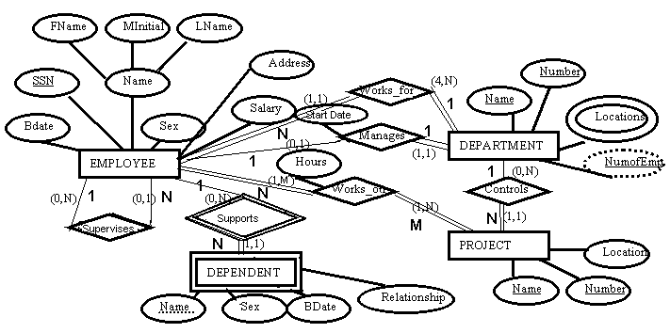
Our Company Example:
CS319

Slide 44
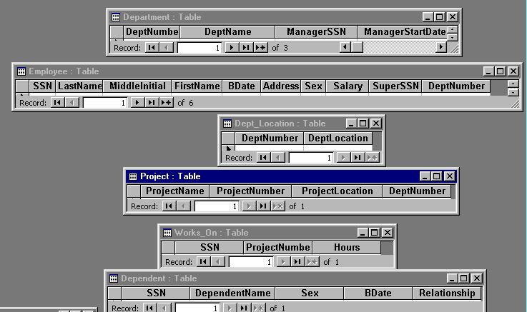
Our Example Mapped to Relations (Tables):
In the above example, I mapped our example to an MS Access Database
CS319

Slide 45
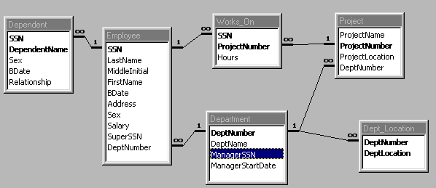
CS319

Slide 46
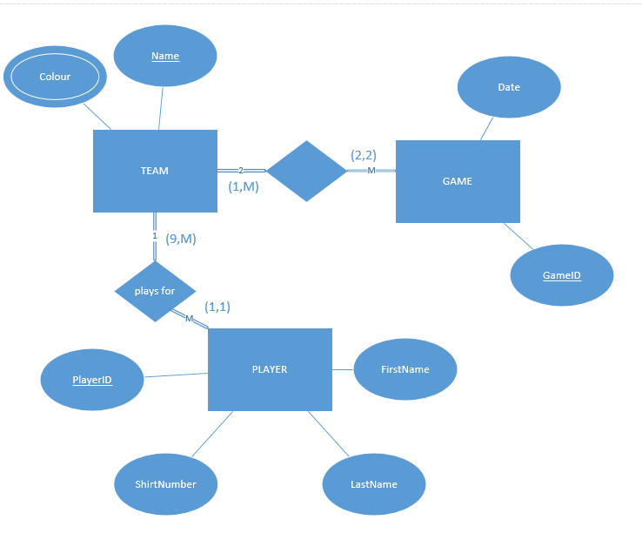
Take the example from slide 1 and map it to a relational database
score
CS3319

Slide 47
Referential Integrity
Referential Integrity: a tuple in one relation that refers to another relation must refer to an existing tuple in the relation.
Formally:
Assume we have R1 and R2 with a referential integrity between the two of them. R1 has a set of attributes FK (foreign key) that references the attributes PK (primary key) R2, it must satisfy the following rules:
FK attributes must have the same domain as PK
a value of FK in a tuple t of the current state r1(R1) either occurs as a value of PK for some tuple t2 in the current state or r2(R2) is null.
CS319

Slide 48
Update Operations on Relations maintaining Integrity Rules
Department
DeptID | DeptName | MgrEmpID | MgrStartDate
G8H | Head Office | 4 | 12/12/99
S7G | Safety Department | 3 | 11/11/98
Y5J | Research Department | 6 | 12/24/98
Employee
EmpID | LastName | FirstName | DeptID | Sex
1 | Simpson | Bart | S7G | M
2 | Smithers | Waylan | G8H | M
4 | Burns | Monty | G8H | M
6 | Simpson | Lisa | Y5J | F
3 | Beuvieau | Patty | S7G | M
12 | Simpson | Homer | S7G | M
CS319

Slide 49
QUESTION: Determine the problems (if any exist) with the following operations to the above tables?
Insert Operation Problem?
Insert <13, 'Gumble', 'Barney', 'S7G', 'Male'> into EMPLOYEE Yes No
Insert <3,'Simpson', 'Granpa', 'Y5J', 'Male'> into EMPLOYEE Yes No
Insert <NULL, 'Flanders', 'Ned', 'Y5J', 'Male'> into EMPLOYEE Yes No
Insert <18, 'Flanders', 'Todd', 'P68', 'Male'> into EMPLOYEE Yes No
Department
DeptID | DeptName | MgrEmpID | MgrStartDate
G8H | Head Office | 4 | 12/12/99
S7G | Safety Department | 3 | 11/11/98
Y5J | Research Department | 6 | 12/24/98
Employee
EmpID | LastName | FirstName | DeptID | Sex
1 | Simpson | Bart | S7G | M
2 | Smithers | Waylan | G8H | M
4 | Burns | Monty | G8H | M
6 | Simpson | Lisa | Y5J | F
3 | Beuvieau | Patty | S7G | M
12 | Simpson | Homer | S7G | M
CS319

Slide 50
Delete Operation Problem
Delete employee where EmpID = 4 Yes No
Delete department where DeptID = 'S7G' Yes No
Department
DeptID | DeptName | MgrEmpID | MgrStartDate
G8H | Head Office | 4 | 12/12/99
S7G | Safety Department | 3 | 11/11/98
Y5J | Research Department | 6 | 12/24/98
Employee
EmpID | LastName | FirstName | DeptID | Sex
1 | Simpson | Bart | S7G | M
2 | Smithers | Waylan | G8H | M
4 | Burns | Monty | G8H | M
6 | Simpson | Lisa | Y5J | F
3 | Beuvieau | Patty | S7G | M
12 | Simpson | Homer | S7G | M
QUESTION: DB2 allows 3 things to happen if you set up referential integrity between keys when you perform a delete, DB2 allows for:
Cascade
Restrict
Set Null
What do you think each of these operations do?
CS319

Slide 51
Modify Operation:
Modify the sex of Employee where lastname = 'Smithers' to Female
Modify Employee where lastname = 'Smithers' from DeptID = 'G8H' to DeptID = 'Y5J'
Modify Employee where lastname = 'Smithers' from DeptID = 'G8H' to DeptID = 'J9J'
Modify Employee where lastname = 'Smithers' from EmpID = 2 to EmpID = 12
Problem:
Yes No
Yes No
Yes No
Yes No
Department
DeptID | DeptName | MgrEmpID | MgrStartDate
G8H | Head Office | 4 | 12/12/99
S7G | Safety Department | 3 | 11/11/98
Y5J | Research Department | 6 | 12/24/98
Employee
EmpID | LastName | FirstName | DeptID | Sex
1 | Simpson | Bart | S7G | M
2 | Smithers | Waylan | G8H | M
4 | Burns | Monty | G8H | M
6 | Simpson | Lisa | Y5J | F
3 | Beuvieau | Patty | S7G | M
12 | Simpson | Homer | S7G | M
CS319

Slide 52
Semantic Integrity Constraints
State Constraints: state the constraints that a valid state of the database must satisfy
Example: Hours worked cannot be greater than 50, Quantity Ordered must be greater than 10
Transition Constraints: define how the state of the database can change
Example: Salaries can only increase
Both of the above are enforce in SQL through triggers and assertions
CS319

Slide 53
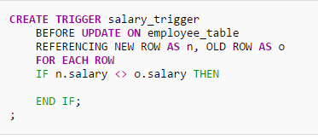
Example of a trigger
Triggers are on inserts, updates or deletes. Can you figure out what this one does?
CS3319

Slide 54
http://www.youtube.com/watch?v=iKK3P11OCyM
CS3319

Slide 55
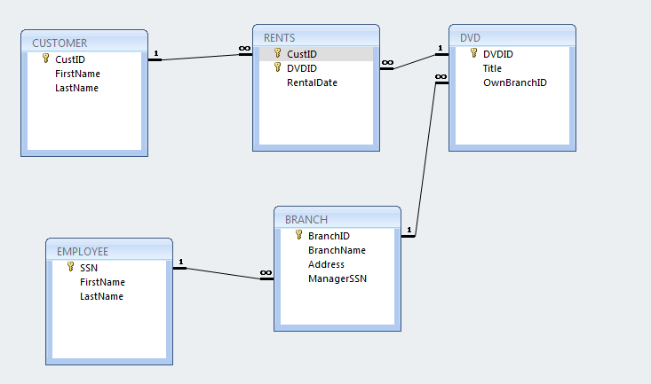
QUESTION: Assume you have the following ER diagram, map it to the appropriate tables:
DVDID
FirstName
LastName
Title
N
DVD
CusID
M
Rents
Customer
N
Belongs to
DateRented
1
Address
SSN
1
1
Branch
Manages
Employee
FirstName
BranchName
LastName
BranchID
CS319

